Slide 1
The Business End of I.T. (Part 1)
Bill Duncan
www.billduncanscareer.com

Slide 2

Class Objectives
Introduce you to broader business concepts; how businesses make money
Highlight the commonalities, differences, and types of opportunities in various business models
Introduce Business Finance ….

Slide 3
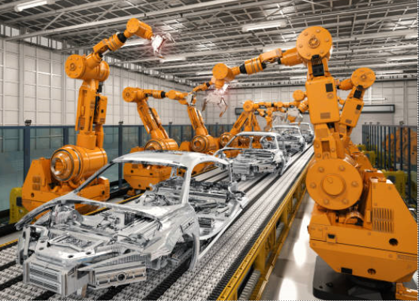

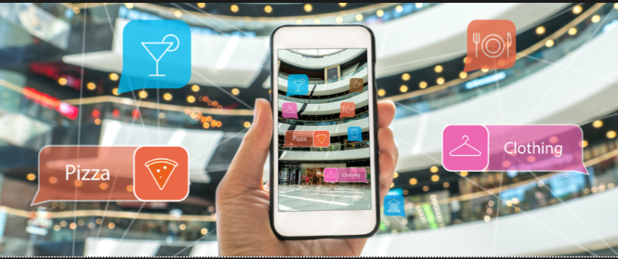


Section #1 Business Models & Their Opportunities
Industrial
Telecom Provider
Retail
Health Care Provider
Financial Service / Lender

Slide 4
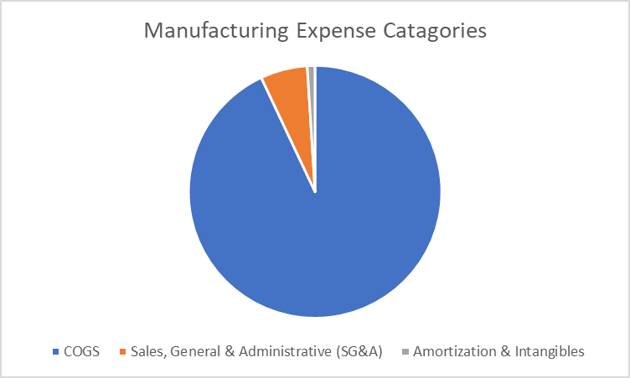
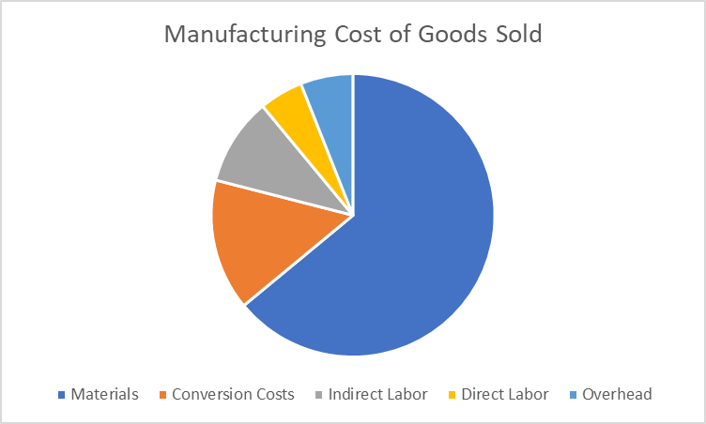
How Typical Business Models Make Money
Industrial:
Heavily capitalized: Plants, machinery, inventory. Substantial margins
Comparatively long lead times: Raw materials, manufacturing, distribution, delivery
Highly sensitive to material costs
Experiencing automation-based transformation in operations, digital transformation in sales, marketing, product development
Notes:
Explain why COGS is so important

Slide 5
Industrial: Most Fertile Opportunities for Profit Improvement
Material Cost Reductions
Yield improvements
Vendor consolidation / negotiation leverage
Material replacements
Maintenance, Repair & Overhead (MRO) Cost Reductions
Vendor consolidation / negotiation leverage
Waste reduction via inventory turns
Logistics Cost Reductions
Route and volume analysis
Vendor consolidation / negotiation leverage
Plant & Equipment Utilization Improvement
ID of critical assets
Capacity Utilization Analysis
Work redeployment
Preventive maintenance
Notes:
What would be a target for ideal inventory turns?

Slide 6
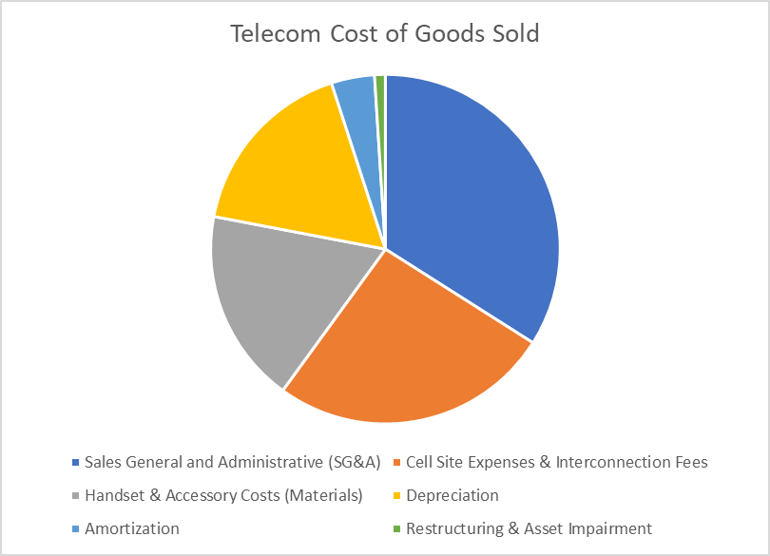
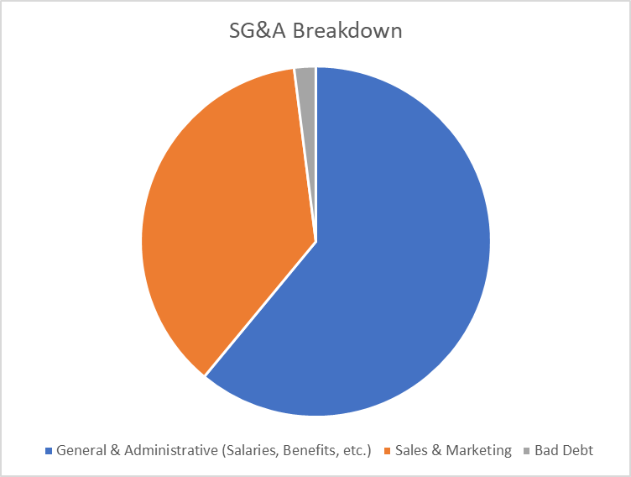
How Typical Business Models Make Money
Telecom Provider:
Medium levels of capitalization for property and inventory
Most investment in cell site equipment & interconnection costs.
Second-highest is Advertising
Third highest is salaries
Substantial margins
Highly sensitive to retail space lease costs, salaries

Slide 7
Telecom: Most Fertile Opportunities for Profit Improvement
Reducing Redundancies
Switches & other network equipment
Distribution centers (and thereby inventory)
Retail outlets (and thereby inventory and salaries)
IT Improvements
Database integration & consolidation (reduces cost and leverages high-cost resources)
Combine wireless, local, and long-distance databases for customers in geographical regions
Enable client to virtually isolate and test an environment containing the full spectrum from sales territories to network services

Slide 8
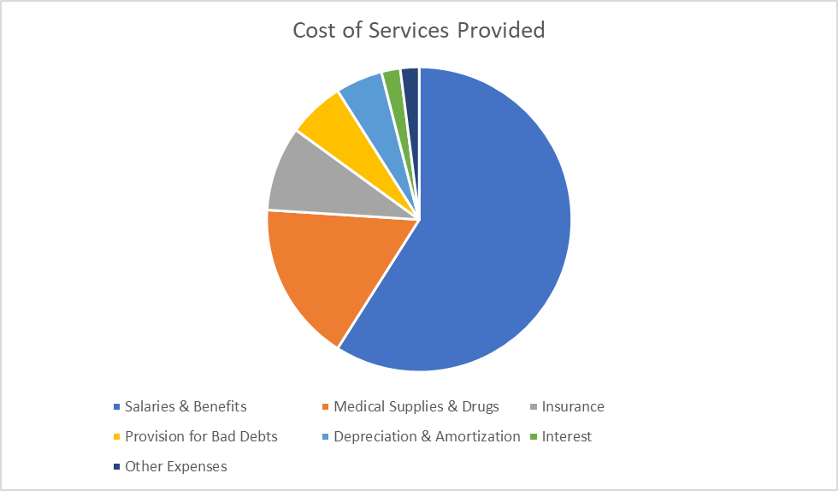
How Typical Business Models Make Money
Health Care Provider:
Medium levels of capitalization, primarily property, with substantial medical supplies / drug related costs
Very sensitive to Salaries & Benefits
Regulation constrained, highly sensitive to PII
Major focus on medical records management
Pharmaceuticals cost management is key issue with baby boomer aging
Notes:
Define PII

Slide 9
Health Care: Most Fertile Opportunities for Profit Improvement
Internet-born Medical Information Availability
Make some information available directly to the consumer (note: Cybersecurity and data privacy issues here)
Take advantage of the advertising revenues flowing from that activity
Identify adjacent markets such as medical care provider listings, continuing medical education (CME), and advertising revenue from publishing health-related magazines and newsletters
Centralizing Functions Around Common Processes & Systems
Centralize processes
Apply standards and common tools in IT areas
Vendor consolidation / negotiation leverage
Critical Equipment Utilization Improvement
ID of critical assets
Capacity Utilization Analysis
Work redeployment
Preventive maintenance

Slide 10
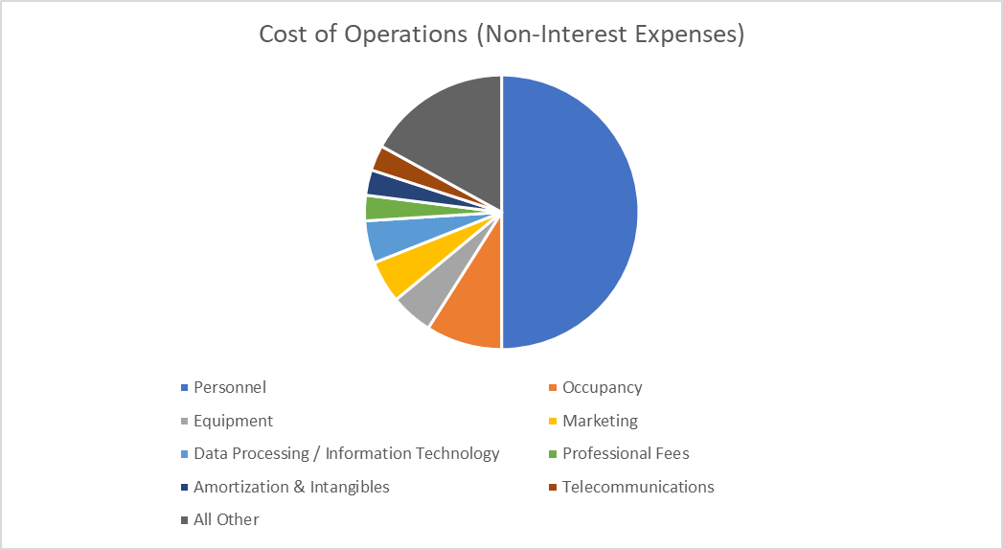
How Typical Business Models Make Money
Financial Lender:
Relatively low levels of capitalization for property and inventory
Relatively high margins – very low overhead levels
Highly sensitive to regulatory environment, prime lending rates
Cost drivers are salaries and property leases
Entirely dependent on information technology

Slide 11
Financial Lender: Most Fertile Opportunities for Profit Improvement
The UMB Bank Story
The banking industry holds similar lessons. In their financial report from 2004, UMB Bank indicated that, following their latest round of acquisitions, they were “….diligently working to become more efficient and to eliminate redundancies across our organization.” While UMB emphasized that they have empowered their regional market leaders by increasing lending authorities, they also mentioned that they had “centralized many of our operations for efficiency UMB said: “….we also began reviewing our branch distribution system. We are carefully looking at each of our locations to determine which has the best
opportunities for the most significant growth. By the same token, we are making the difficult decisions to close branches that do not present bottom-line contribution and a reasonable opportunity for future growth. This process is critical to our future success.”
This focus on gaining commonality in processes and systems, and using that commonality to leverage the enterprise-wide assets of the business, is indeed critical to success – not only for UMB Bank, but for all companies that intend to mature effectively and grow.
Evaluate Branch Distribution System
Eliminate redundancies / overlap in territory coverage
Standardize lending authorities, matched to regional needs
Develop systematic evaluation and culling process for closing down poor performing branches
Personnel Cost Reductions
Centralization and commonization of processes and systems
Consolidation and reconfiguration of the organization to face the customer base more effectively
Improve Marketing
Identify success criteria for sales campaigns, match to relevant regions to improve batting averages
Waste reduction via inventory turns

Slide 12
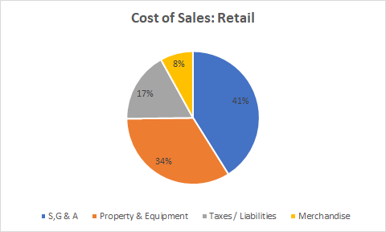
How Typical Business Models Make Money
Retail:
Medium level margins, but low margins (~3% at WalMart, Target) Requires volume for success
S,G & A (Salaries) are often 30% of COGS
High property / lease costs – typically 25% of COGS
Highly sensitive to inventory turns
Food retail is highly sensitive to shelf life
Heavily impacted by social media – both as a sales tool and as a quality checking source

Slide 13
Retail: Most Fertile Opportunities for Profit Improvement
Shifting from “Bricks to Clicks”
Reduces salary / personnel related costs
Dramatically reduces property / equipment costs
Improvements in On-Line Marketing & Sales
Improves market access to younger consumers
More rapid response to trends in discretionary spending
Closer to real-time market trend visibility
More rapid response to safety / quality concerns
Partnering with On-Line Oriented Delivery Entities
Uber
Other private contractors

Slide 14
Approaches for Targeted Improvement
Revenue Growth: Internet-based competitive intelligence, market analysis, market studies. Agile prototyping & sales. Developing revenue streams based on insights (Machine Learning)
Cost Reduction – Materials: Vendor Consolidation, Materials consolidation (Data Science & Analytics)
Cost Reduction – SG&A: Sales territory consolidation, Retail property consolidation, shared service implementation (Data Science & Analytics)
Cost Reduction – Overhead: Plant / property / equipment utilization improvements, lease consolidations, transportation consolidation (Machine-to-machine communication / IIoT, Analytics, Visualization)
Cost Reduction – Direct & indirect Labor: Robotic process automation (RPA) and Chat-bots
Notes:
Introduce concept of DuPont model here

Slide 15
Individual Exercise
Select 1 improvement opportunities (New Market Segments, Rationalized Product / Service Portfolio, Raw Material Cost Reduction, etc.)
Provide an example of where you have seen this approach implemented, and speculate about:
What data was required?
What tools / techniques were likely utilized to process that data?
How were the types of results targeted? (Increased sales, lower cost, higher quality, faster time-to-market?)
Present your work to the class

Slide 16

Key Differences
Industrial:
Supplementing physical product one-time sales with embedded software upgrades, product data collection, subscription to insights, and remote monitoring of product performance
Shifting nature of product and service development and product support
Retail:
Shift from “bricks to clicks” reducing capital exposure, shifting labor costs, shifting nature of sales / marketing means different skill sets for product and service developers
Health Care:
Preoccupied with cyber security after recent hacks of Blue Cross / Blue Shield, others. Struggling with staffing availability, escalating cost structure
Looking for automation opportunities. Also trying to drive rapid turnover of facility occupation
Telecom:
Fiber backbone across North America, Europe – still growing in China
Big news in the industry is 5G. Enabler of IoT and IIoT – multi-trillion-dollar demand in next couple of years. Current concern about security of Huawei as a provider for much of the 5G equipment.
Big push to edge-based computing, including AI/Machine Learning. Industry shift from on-premises data centers to cloud-based operations along with demand for portability driving transformations in infrastructure to support data volumes, types
Financial Services:
Ever-changing regulatory requirements
Big news in this industry is crypto-currency – ranging from PayPal to Block Chain to the new Apple currency (Libra)
Intense competition – everyone is lending money these days – leading to rapidly reconfiguring market space

Slide 17

Key Similarities
Moving to Cloud-based Operations
Cybersecurity Challenges
Information Protection & Privacy Challenges – Increasing Regulation
Net Results:
Digital transformation (IoT / IIoT)*
Skill set requirements changing (Data Science, APIs, ML/AI, AR, BlockChain)
Development methodology changing (Waterfall to Agile)
Cybersecurity / data privacy at the heart of everything
Automation offering opportunities to lower staffing cost, improve service speed, and improve consistency / quality (RPA)
Digital Transformation is the changes associated with digital technology application and integration into all aspects of human life and society. It is the move from the physical to digital.

Slide 18
Section #2 Business Finance
Industrial
Telecom Provider
Retail
Health Care Provider
Financial Service / Lender

Slide 19


Measuring Business Financial Performance: RONA & ROTC
Working Definitions
Pretax earnings is a company's income after all operating expenses, including interest and depreciation, have been deducted from total sales or revenues, but before income taxes have been subtracted. ... Also known as pretax income or earnings before tax (EBT).
External revenue is income generated from activities outside of the company. It broadly encompasses all outside business activities, such as the sale of products or services.
Net assets are total assets minus total liabilities of an individual or company.
Operating Profits are income resulting from a firm's primary business. (Formula: Sales revenue - (cost of goods sold + operating expenses)
Operating Capital is the cash available for day-to-day operations of an organization.
RONA: Return on Net Assets
RONA =
ROTC: Return On Total Capital
ROTC =
Notes:
Do you want to include EBITA? Earnings Before Income Taxes and Amortization

Slide 20

How Businesses Make Money
Campbell’s Soup
Adobe
Stanley Tools
Levis
Inbev
General Motors – Chevrolet
Bank of America
Total Comfort Heating & AC
Boeing
Barnes Jewish Hospital
Best Buy
Tesla
Build / sell hardware
Build / sell and support hardware
Build / sell hardware with embedded software
Build / sell and support hardware with embedded software
Build / sell software products & services
Buy / inventory / sell products
Buy / inventory / sell products and support services
Pure service provider (such as health care)
Primarily an Installer with some secondary product sales (HVAC, Telecom)
An increasingly blurred set of lines between these business models!

Slide 21
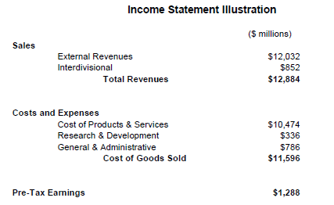
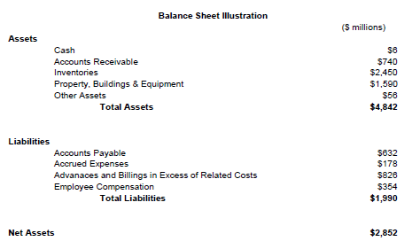
The Two Components of Business Finance
Income Statement
Balance Sheet

Slide 22
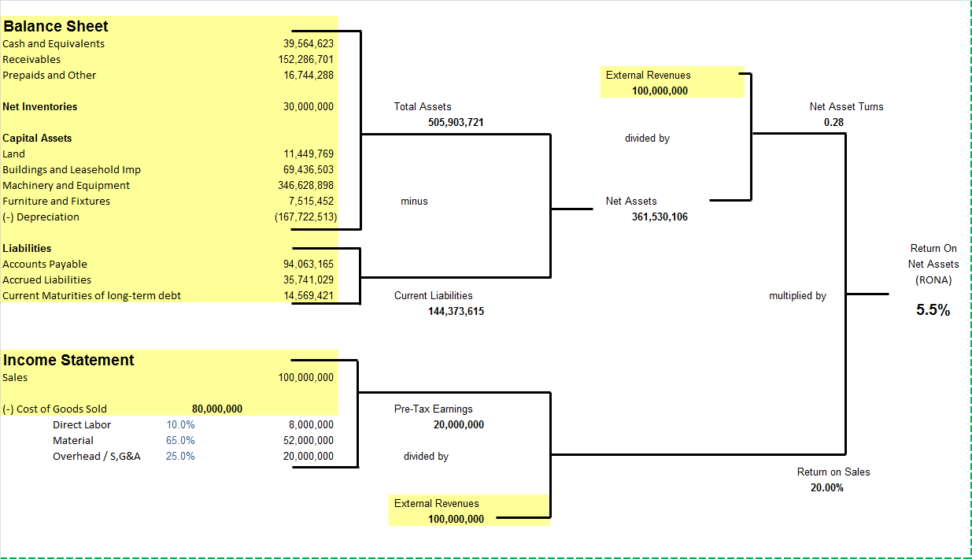
The DuPont Model
Notes:
Developed in 1912 by Donaldson Brown; DuPont adopted for use in the 1920s

Slide 23
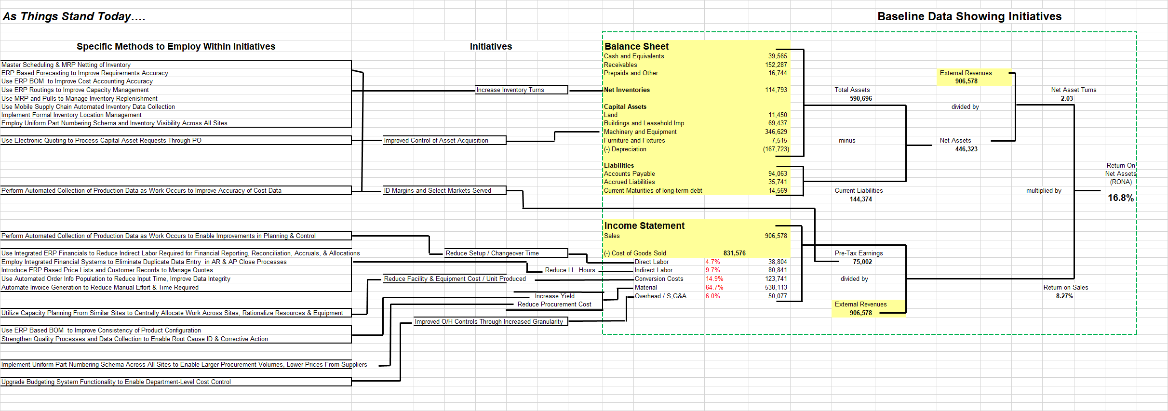
Before and After
BEFORE
Notes:
Walk through as a class, but provide the model in Excel for those who want to play with it a bit more.

Slide 24
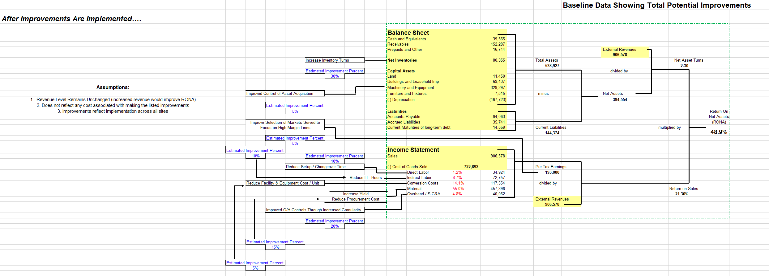
Before and After
AFTER

Slide 25
The DuPont Model Sensitivity Analysis
Exercise:
Which change the RONA number more?
A 25% reduction in net inventory
A 10% increase in sales
A 15% reduction in material cost
A 50% reduction in direct labor cost
Consider collateral impacts!
Notes:
Demo the first calculation: ask what factor(s) are affected, show how to use the file
Incorporate the RONA % after each change and bring up after that discussion a) 18%, b) 3711%, c) 34.9%

Slide 26

IT and Our Impact on Profitability
Typical IT Spend as a % of Sales*:
Industrial: 1.4% to 3.2%
Financial Services: 4.4% to 11.4%
Telecom: 2.6% to 4.7%
Health Care: 3.0% to 5.9%
What happens if I completely eliminate IT spending?
What happens if I spend 50% more on IT to get a 10% savings in materials cost?
Source: Computer Economics, 2019
Notes:
Maybe use some of the recent stats from Shaw on this?

Slide 27



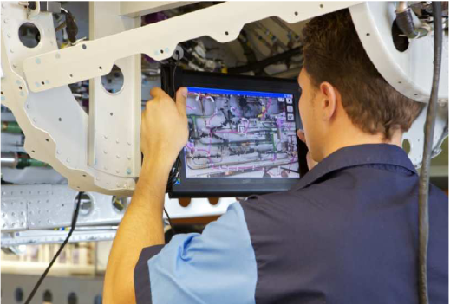

New Ways to Use IT to Improve Profitability
RPA
Robotic Process Automation (RPA)
Apply Machine Learning (ML) to existing databases
Apply Machine Learning (ML) in IIoT Operations
Build analytics into new IoT products / services
Apply Augmented Reality in training scenarios
Apply Augmented Reality in work instructions
Apply Block Chain to Logistics Management
Augmented Reality
Analytics

Slide 28
Team Based Exercise
Divide into 4 teams (Industrial, Telecom, Health Care Services, Financial Lender)
Review the background of your client’s type of company
Identify 2 biggest opportunities for IT related improvement
Develop at least 1 approach for each opportunity:
What data do you need?
What tools / techniques will you apply?
What will the deliverable(s) of your work be?
How will the results impact profitability / company success?
Present your work to the class
Notes:
Where would the impact show on the DuPont model?

